Slide 1
Lecture 4a One last example Calculating polynomials

Slide 2
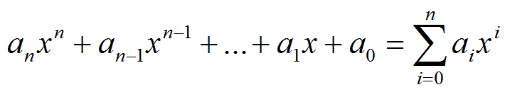

Example 3: Calculating the value of a Polynomial
A polynomial of power n:
where
We’ll see that
Standard method [≈n²/2 mult.+ n add] O(n²)
Horner’s method [n mult.+ n add] O(n)

Slide 3

Standard method
y = a[0]
for i in range(1, n+1):
y += a[i]*exp(x,i)
n additions + multiplications
n additions + n²/2 multiplications
O(n²)
i-1 multiplications
1 multiplication

Slide 4
exp
exp(x,n) = x^{n}
y = x
for i in range(n-1):
y *= x
(n-1) multiplications

Slide 5
Horner’s algorithm
y =
y = …((a_{n})x+a_{n-1})x+…+)x+a₂)x+a₁)x+a₀

Slide 6
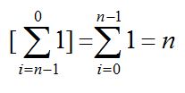
Horner’s algorithm
y = a[n]
for i in range(n-1,-1,-1):
y = y*x + a[i]
n [additions, multiplications]
O(n)
Recall that the standard algorithm was O(n²)

Slide 7
# a is a list of indexes
def horner(a,x):
n=len(a)-1
y = a[n]
for i in range(n-1,-1,-1):
y = y*x + a[i]
return y
>>> from myLib import *
>>> a=[4,-2,1,2]
>>> res=horner(a,5)
>>> res
269
Horner is in myLab3.py
2x³+x²-2x+4

